Slide 1
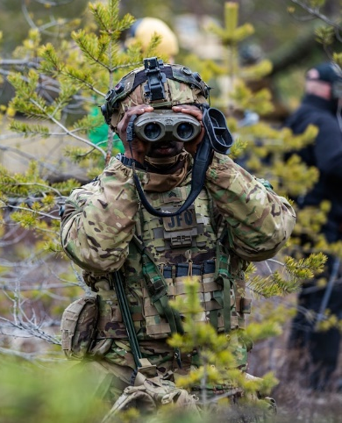
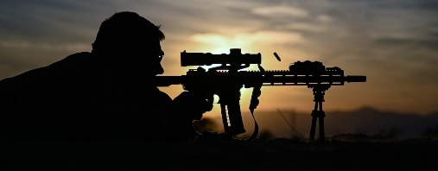
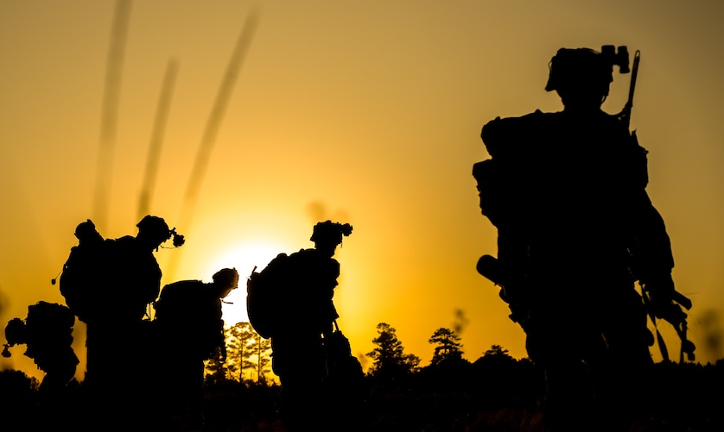
Example SCOUT CARD
Warfighter ACS
Company Logo
Name of Company
POC: name/phone/email
Problem
Technology name, picture, and a brief description:
Adaptive Camouflage System (ACS) allows the Warfighter to hide in plain sight.
What problem do you solve?
Warfighters face increased vulnerability due to their visibility in various environments, making them susceptible to detection and attacks.
Next-generation stealth is required for the Joint Force to conduct Multi-Domain Operations.
Solution Specifics
How do you solve the problem?
The Adaptive Camouflage System utilizes advanced materials and real-time image processing to dynamically adjust the appearance of military personnel and equipment, providing effective camouflage in different terrain and conditions.
ACS seamlessly blends with the surroundings,
significantly reducing the chances of detection
by enemy forces.
Impact and Technical Approach
Technology Readiness Level (TRL): 6 | ACS has been demonstrated in a relevant operational environment in DAX ’22 with positive feedback from Special Operations Soldiers.
What is the Impact of your Solution?
The impact of the Adaptive Camouflage System includes enhanced survivability, reduced risk of enemy detection, improved stealth capabilities, and increased operational effectiveness in various mission scenarios.
The Technical Approach: NC A&T patented engineering principles used to create and advance the technology.
Performance
End-user payoff/expected operational value/new capability: ACS is a transformational innovation to increase protection for Warfighters, reduce casualties, improve mission success rates, and enhance operational flexibility.
Dual-Use (Commercial / Military) applications for the technology solution: Integration into Law Enforcement, commercial security systems, wildlife tracking and monitoring, and stealth surveillance for hunters.
Notes:
3-Minute pitch script: The end user: Warfighters who must be concealed in various environments.
[Opening]
Speaker: Good morning. Thank you for being here today.
My name is [Your Name], and I am here to introduce you to the Adaptive Camouflage System (ACS), a groundbreaking technology that allows the Warfighter to hide in plain sight.
[Problem]
The problem we aim to solve is clear. Our Warfighters face increased vulnerability due to their visibility in various environments, making them susceptible to detection and attacks. Next-generation stealth is required for the Joint Force to conduct Multi-Domain Operations. The need for effective camouflage has never been more crucial.
[Solution Specifics]
Enter the Adaptive Camouflage System (ACS). This cutting-edge technology utilizes advanced materials and real-time image processing to adjust the appearance of military personnel and equipment dynamically. The ACS provides effective camouflage in different terrain and conditions, seamlessly blending with the surroundings. Doing so significantly reduces the chances of detection by enemy forces.
[Impact and Technical Approach]
The Adaptive Camouflage System has reached an impressive Technology Readiness Level (TRL) of 6. It has been successfully demonstrated in a relevant operational environment during the DAX '22 exercise. The impact of our solution is substantial. With the ACS, Warfighters will experience enhanced survivability, reduced risk of enemy detection, improved stealth capabilities, and increased operational effectiveness in various mission scenarios.
Our technical approach is based on patented engineering principles and scientific methods. We have employed the expertise of leading engineers and researchers from NC A&T University to create and advance this technology, ensuring its effectiveness and reliability.
[Performance]
The performance of the ACS is truly remarkable. Our solution offers an unparalleled end-user payoff and expected operational value. With the ACS, Warfighters will experience increased protection, reducing casualties and improving mission success rates. This transformational innovation enhances operational flexibility, empowering our Warfighters to accomplish their missions more confidently and effectively.
[Dual-Use Applications]
The potential applications of the Adaptive Camouflage System extend beyond the military domain. Its dual-use nature allows for integration into Law Enforcement, commercial security systems, wildlife tracking and monitoring, and stealth surveillance for hunters. This opens up new avenues for collaboration and commercialization, making the ACS a valuable asset across different sectors.
[Closing]
In conclusion, the Adaptive Camouflage System is a game-changer in military technology. With its advanced materials, real-time image processing, and unmatched effectiveness, the ACS revolutionizes how Warfighters conceal themselves in the field. We invite you to join us in harnessing the power of this transformative solution for the benefit of our Warfighters and beyond.
Thank you for your attention. My team and I are available to answer any questions you may have.

